Slide 1
Cover letter types and formats

Slide 2
Why your cover letter format is important?
The format you choose for your cover letter determines which information you include as well as the order in which it is distributed. It determines how the hiring manager perceives you and helps develop his or her first impression of you.

Slide 3
Types of Cover Letter Formats
1. APPLICATION COVER LETTER
This is the standard cover letter used alongside a resume during a job application. The application letter is geared toward a certain job, and it is tailored to the skills and specifications listed in the job posting.
The application cover letter is a tool used to sell yourself as a job candidate. It supplements your resume and expands upon relevant parts of your work history and qualifications.

Slide 4
2. PROSPECTING COVER LETTER
Like the application cover letter, the prospecting cover letter is written by a job seeker to a company of interest.
This type of cover letter inquires about open job positions in general. It is not a response to a specific job posting.

Slide 5
3. NETWORKING COVER LETTER
This type of cover letter is the most casual and tends to be the shortest. It still comes from the job seeker, but rather than being sent to a company, it is sent out to former colleagues, mentors, friends and other contacts.
It informs the recipient of the person’s status as a job seeker and asks them for help in their job search.

Slide 6
The “Non-cover Letter” Cover Letter
This cover letter is simply an introduction to your resume. It is professional but very short.
This type of cover letter is great to use when a formal cover letter is not requested in the job posting.
Does not follow a specific format. It usually includes a greeting, simple body explaining your experience and your interest in the company and a closing with reference to any attachments such as your resume, portfolio, samples or any other requested documents.
If you are emailing your resume, it is always a good idea to write a quick, professional email to go along with it. It should be short--a couple of paragraphs is sufficient--and the tone should remain casual but professional throughout.

Slide 7
How to draft a cover letter

Slide 8
Application Cover Letter
Contact Info---Full name, address (including zip code), phone number and email address
Greeting--- Always address the hiring manager by name. If you don’t know it, consult the company website or give the office manager a call to find out. A simple, “Bill” is all you need in your greeting.
Opening --- Who are you? What skills and accomplishments best describe you and are also relevant to the job position?
Body (1-2 paragraphs)---- What do you know about the company already? Why are you applying for this specific job? What can you bring to the company and job position?
Closing----Refrain from sounding too desperate with phrases like, “I can’t wait to hear more about this position”. A good alternative is “I’m looking forward to finding out if I’m a match for this position”. Mention any attachments. Use “Sincerely”, “Yours” or “Best” before signing your full name.

Slide 9
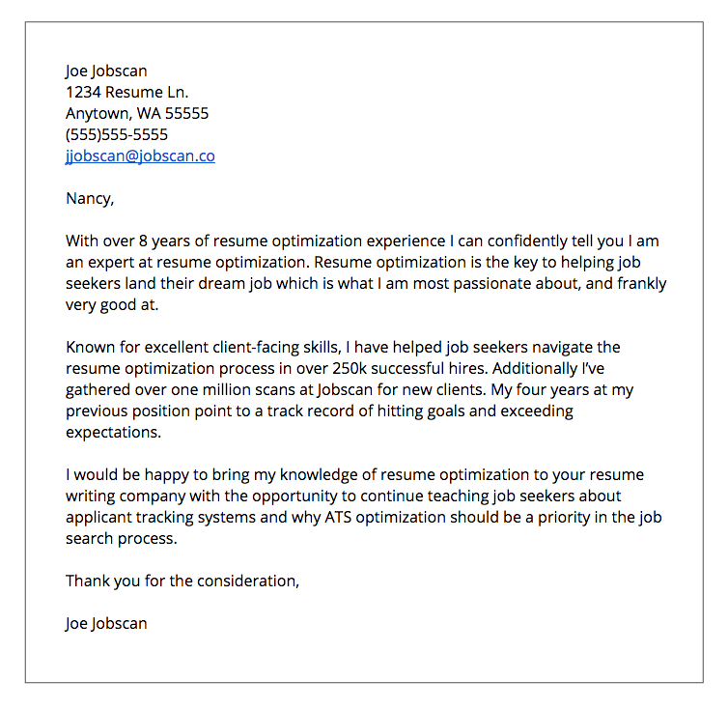
Sample for Application Cover Letter

Slide 10
Prospecting Cover Letter
The prospecting cover letter is setup much like the application letter. The only differences occur in the opening. The body might change slightly based on the company, but many times it will remain the same.
Contact Info
Greeting
Opening
Why are you reaching out?
What interests you about the company?
Body (1 paragraph)
Who are you?
What skills do you have that could help the company in general?
What have you accomplished in your career that could be of interest to the company?
Closing

Slide 11
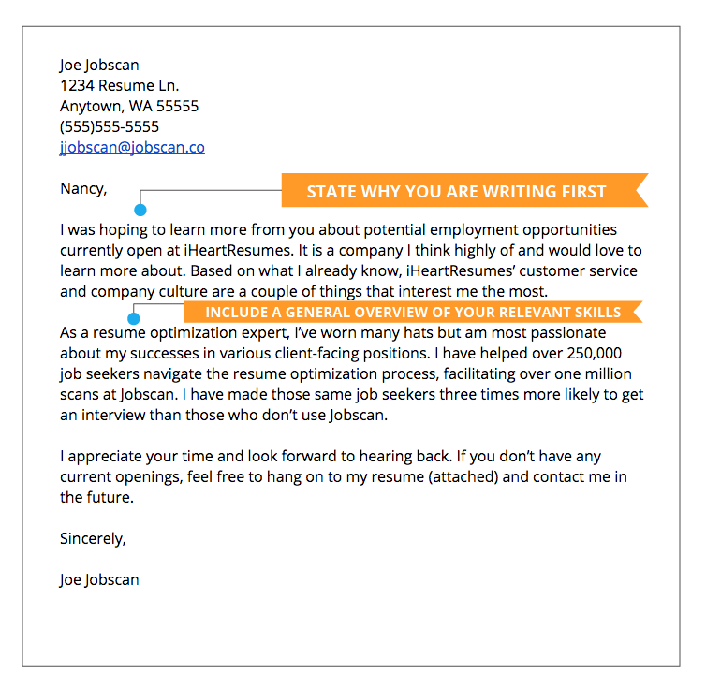
Sample for Prospecting Cover Letter

Slide 12
Networking Cover Letter
The networking cover letter, being different in purpose than the first two, keeps only the contact info and closing the same.
Contact Info
Greeting
Can be more casual than the other cover letter greetings if you have a relationship with the person.
Opening
Why are you reaching out? Do you want referrals? Recommendations?
What kind of job/company interests you?
Body
What skills and accomplishments should they be aware of in order to help you out?
What do you hope to accomplish in your next position?
Closing

Slide 13
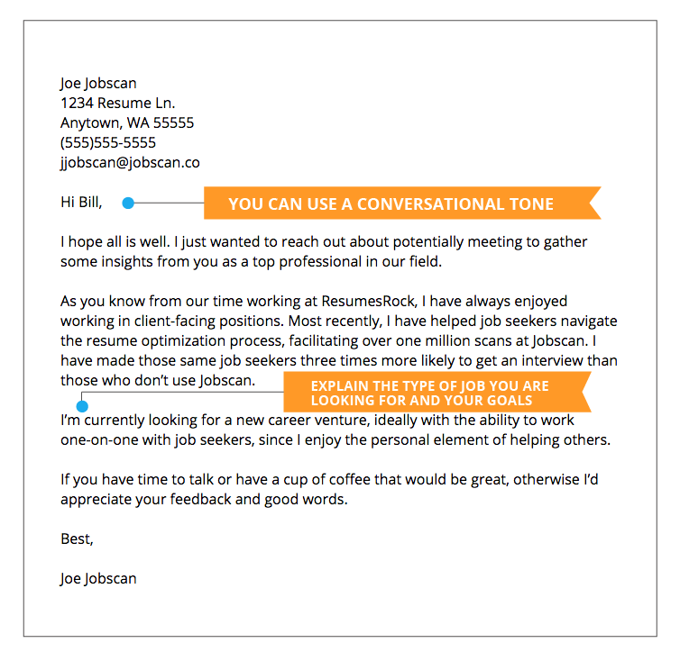
Sample For Networking Cover Letter

Slide 14

Activity
How about writing an application letter to a company (of your own choice/dreams)?

